Slide 1
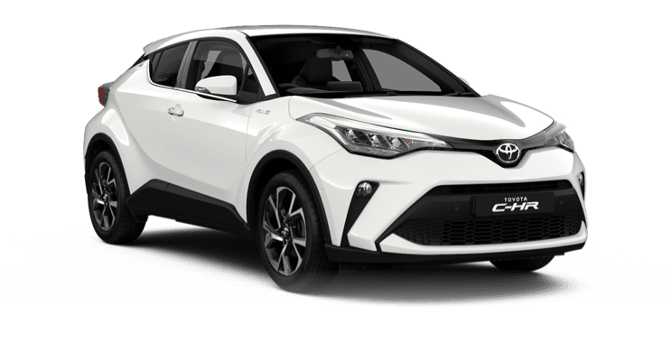
Hybrid Cars
A compromise between electric and combustion engine cars.

Slide 2

What’s the purpose?
Reduce emissions
Improve fuel efficiency
Transition technology

Slide 3
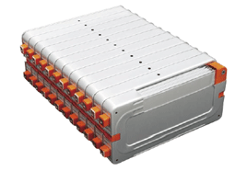
Specifications :
Dual engine system (electric and combustion)
Regenerative braking
Battery capacity and type
Exemple image of an hybrid car battery.

Slide 4
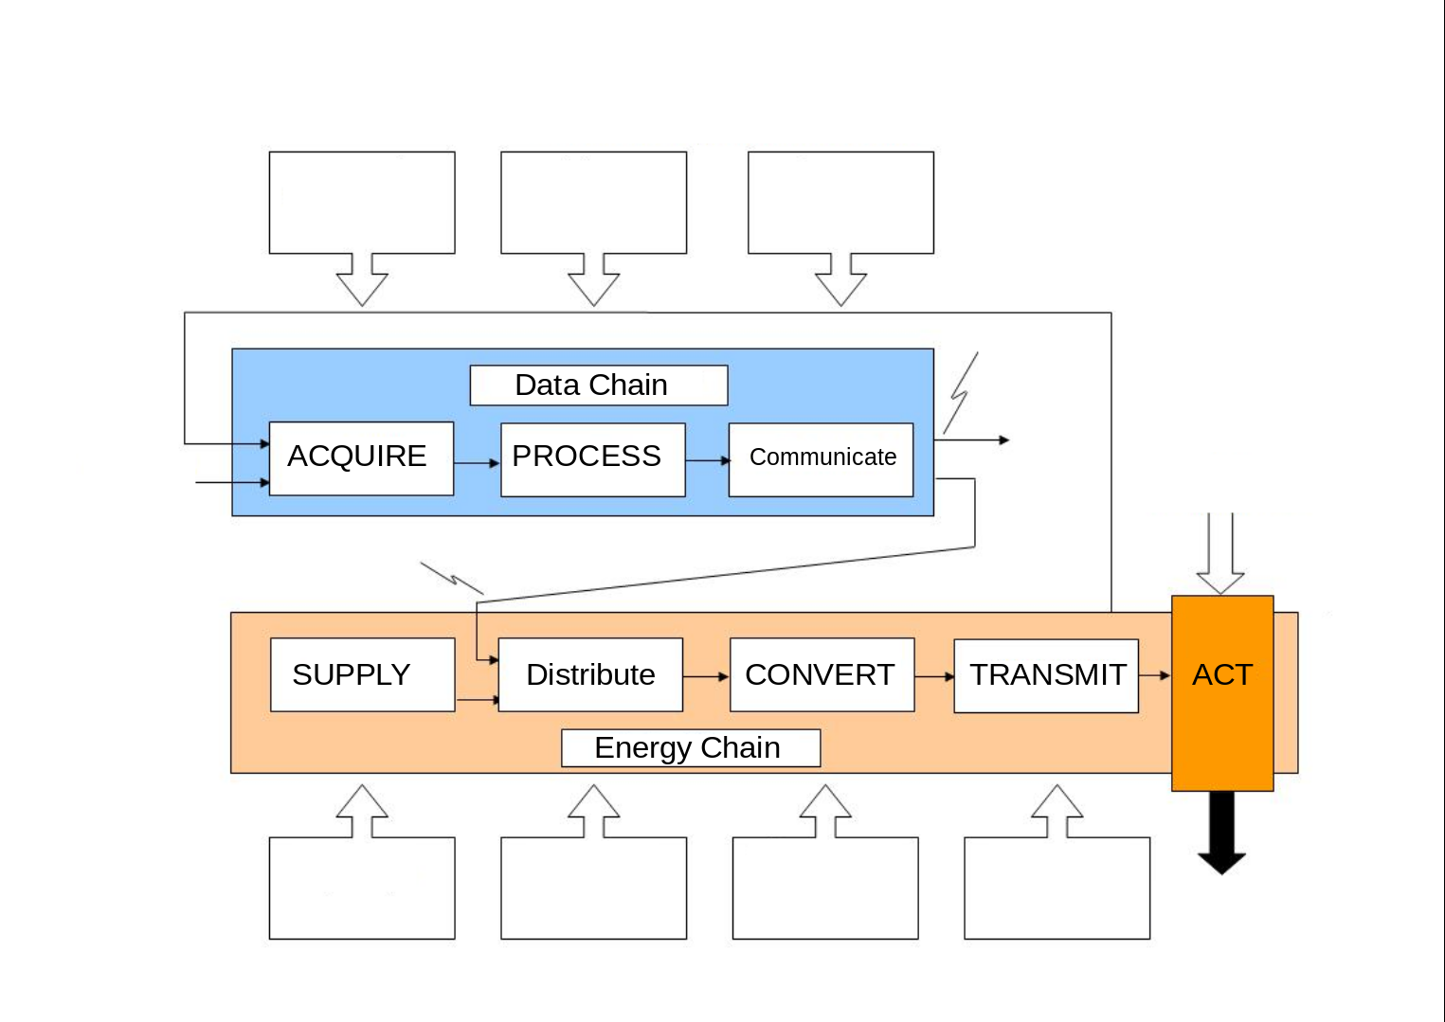
Captors
CPU
Display
Fuel or Battery
Pump or Powerboard
Thermal or Electric Motor
Transmi-ssion

Slide 5
Opinion & conclusion
Future potential
Cost vs benefits
Personal viewpoint on sustainability

